Slide 1
Introduction
Adaptive clause deletion via early search dynamics prediction in CDCL solvers
Modern CDCL SAT solvers utilize only ONE clause deletion policy, hence main hypothesis is:
Adapting clause deletion policies based on early search dynamics leads to better solver performance than a uniform clause deletion strategy.
RQ1: To what extent are SAT and UNSAT instances distinguishable by early CDCL search dynamics? - Establish that early probing gives meaningful signals. – Plot features(x), SAT/UNSAT(Y) (historgram, boxplots etc, optiontally PCA/UMAP). Also consider t-test/ Mann-Whiten U test for quantitative proof over just visual
RQ2: Can early search dynamics predict which deletion policy (AGG vs CONS) will perform better for a given instance? - Test feasibility of ML-based policy selection. > Evaluate predictive accuracy post-model training.

Slide 2
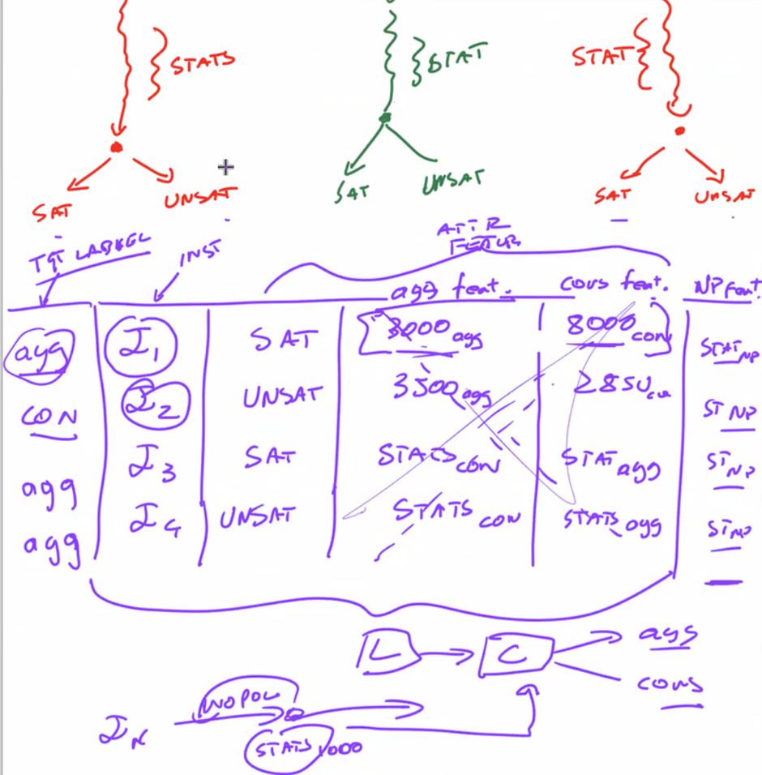
Methodology / Proposed Solution
Offline Phase
Run the solver with Agg deletion, Cons deletion and gather the target labels (Con/Agg) for best performing policy – Y Variable
Run the solver with NO policy(baseline) for the first 2K Conflicts, gather the search dynamics from this solver to act as features. - X Variables
Train model (Cross-validate, evaluate, etc)
Online Phase
CDCL Starts solving new instance with No Policy(baseline) for first 2k conflicts
Extract early features
Feed early features into trained model
Model predicts AGG or CONS
Depending on the prediction, set AGG or CONS deletion strategy (solver switches to corresponding predefined configuration)
Solve until termination
This will all be done on MiniSAT 2.2 as the base CDCL Solver since it is the classic CDCL.

Slide 3
Coding Steps
Inside MiniSAT 2.2, create variables for 3 deletion modes (Base ,Agg,Cons) (C++)
Modify reducedDB function for the 3 deletions modes (C++)
Data generation for recording the features and labels > Store in vector files (C++)
Load features + labels > Train model (cross-validate etc & select best model) (Python)
Extract learned parameters (Python)
Embed the model back into the solver (C++)
Results.

Slide 4
Features Examples (Search Dynamics)
Clause database growth
Avg LBD
Conflict clause size
Propagation rate
Restart frequency
etc.

Slide 5
Literature
Theoretical background (P vs NP – Very short)
DPLL Algorithm
CDCL Algorithm
ML Utilization in SAT solvers
NeuroBack (Selecting which variable to use and state of that variable)
ML-Based Restart Policy for SAT Solvers (When to discard a search and restart – includes early search dynamics for restart policy within the online model itself)
Predicting Learnt Clauses Quality in Modern SAT (Which clause to retain or delete – not technicaly ML hence kept minimal )
NeuroSelect (Which clauses to retain or delete – includes heavy clause deletion policy)
https://aitp-conference.org/2020/slides/PV.pdf - sent via email, will be my base paper I think but have yet to do literature on it.
picks a deletion threshold (e.g. LBD <= 3) and learns via RL where a neural network continuously (hence an online model) decides how aggressive deletion should be. Scope: Given the current state of the solver, what deletion threshold should I use right now? - Updating in real time (Approximation and determinstic)

Slide 6
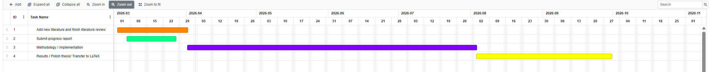
Gantt Chart

Slide 7
Thesis Schedule
27 March > Progress Report
17 April > Progress Report Feedback
26 June > Deadline for change in thesis title
28 August > Dissertation extension request deadline
1 September > Students should have submitted first drafts of thesis for correction
15 September > Deadline by which supervisor should give feedback on the draft
30 September > Dissertation deadline (copy to be sent to Elton Mamo)

